Slide 1
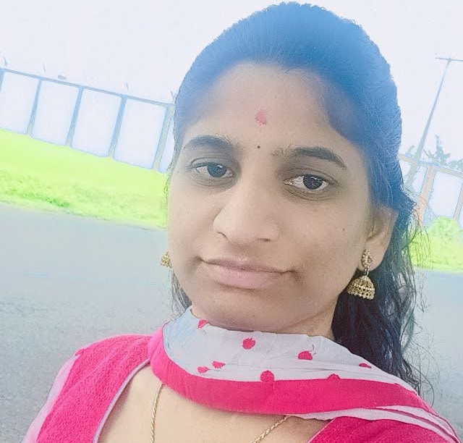



Godavarthi Bhavya
Analyst/Software Engineer
Bachelor of Engineering
Computer Science : 2017 - 2021
Skills
Java 8 /J2EE | Java Basics, OOPS, Generics, Collections, Arrays, Loops, Lambda Exp, Stream API Junit, Mockito, Servlets
Spring core | IOC & Dependency Injection, Autowire
Spring REST | REST controllers, Implementation of GET, POST, PUT & DELETE, Bean Validation & Exception Handling, Testing Services, Controller & Repository layer
Spring Data JPA | Implement DAO layer using spring Data repositories, Transaction Management
Spring Boot Microservices | Spring Boot Starters, annotations, Messaging Service, Sync/Async comms, Swagger API documents
Spring Cloud | Eureka, Netflix Ribbon, Feign Client, Netflix Hystrix, Netflix Zuul & Config Server
React | Components, Hooks, Event handling, Redux, Reducers, Testing using Jasmin & Karma
Angular | Components, Services, Modules, Routing, Forms & Validation, Testing using Jasmine & Karma
Database | MongoDB No Sql Basics My SQL RDS Basics
UI Tech | HTML 5 & CSS 3,JavaScript, ES6 & TypeScript Reusable templates, Optimized UI Designed
Tools | Git, Postman, Maven, IDE
Devops | CI/CD, Jenkins configuration, Build Pipelines, notifications, quality gate understanding
Add On skills | Communications, Team management. Peer learning
Hyderabad
Godavarthi.bhavya@capgemini.com
+91 9553828362
A4
Full Stack Developer
Hands on experience in creating microservices with Springboot, Spring Security, Spring Cloud API Gateway, Eureka server, resilience 4J, load balancing, Feign, Sleuth and zipkin
Proficient in creating Single page Web Application in React with Authentication with route guards, reactive forms, routing, Tailwind CSS
Hands on experience in implementing polyglot architecture with ReactjsJs & spring boot
Experience in creating documentation with Java docs and swagger and in unit testing using Junit, Mockito including code quality compliance using Sonar cube
Development experience in creating docker images and pushing to Docker Hub with containerized applications using Docker SWARM
In-depth understanding of deploying spring boot applications in AWS Cloud environment
E-Commerce Agriculture crop system Application
Completed end to end case study of Agriculture crop system Application along with JWT authentication, Swagger andMongodb, responsive UI with CSS and React js used for user interface.
Aws Certified.
Check out my work on GitHub & Video Profile

